Slide 1

Making this resource work for you
Prior to teaching this lesson, please refer to the ‘Unit Overview and Planning Document’.
Further guidance on planning Science Mastery lessons can be found in the detailed planning guidance document.
Refer to the ‘notes’ section on each slide for useful information, including suggested expositions, pedagogical content knowledge, suggested questions, answers and more. Consider using presenter mode so you can see this guidance throughout the lesson.
The introduction slides can be adapted to suit your teaching style and the needs of your class.
Before the lesson, adapt the fix-it slide to address any misconceptions identified in the previous lesson’s exit ticket.
Choose from the suggested activities to suit your class. The intention is not that you complete all of these, but that you select those which ones are most appropriate for your students. It may be appropriate to further adapt activities for your students.
These lessons are designed to occupy approximately 1 hour. To adapt for a shorter or longer lesson duration we advise you to adapt the activity section accordingly.
Please consider using the final slide to send feedback about this lesson or examples of PowerPoints that you have adapted to our design team. Your feedback is used to improve Science Mastery for all of our teachers and students. We appreciate all suggestions and comments.
Thank you for reading!
The Science Mastery Team

Slide 2

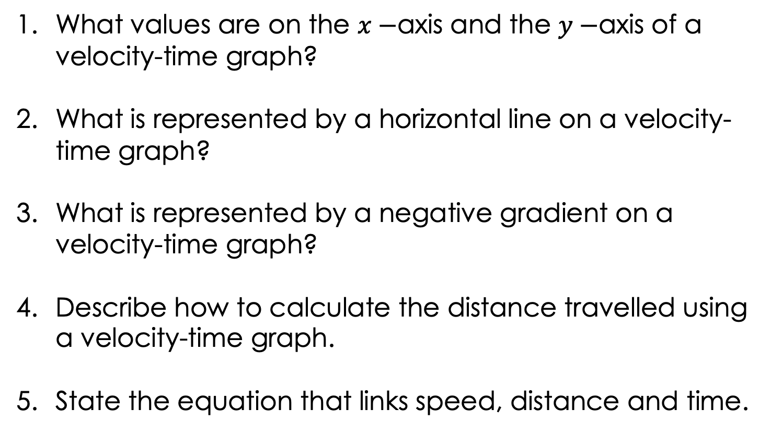
Velocity-Time Graphs 2
Answer the following questions:
What values are on the $x−$axis and the $y−$axis of a velocity-time graph?
What is represented by a horizontal line on a velocity-time graph?
What is represented by a negative gradient on a velocity-time graph?
Describe how to calculate the distance travelled using a velocity-time graph.
State the equation that links speed, distance and time.
Time is on the $x−$axis and velocity is on the $y−$axis.
An object travelling with constant velocity.
Slowing down/decreasing velocity/deceleration
The distance travelled is the area under the graph.
$$Speed= \frac{Distance}{Time}$$
Notes:
Foundation question: State the definition of acceleration.
Answer: Acceleration is the rate of change of velocity.
Stretch question: Describe the motion shown in the above velocity-time graph.
Answer: The object is accelerating from 0 to 10 m/s in the first 5 seconds, then it travels with a constant speed of 10 m/s for 5 seconds. It then accelerates again from 10 m/s to 14 m/s in another 5 seconds before decelerating to a stop in the last 5 seconds.

Slide 3
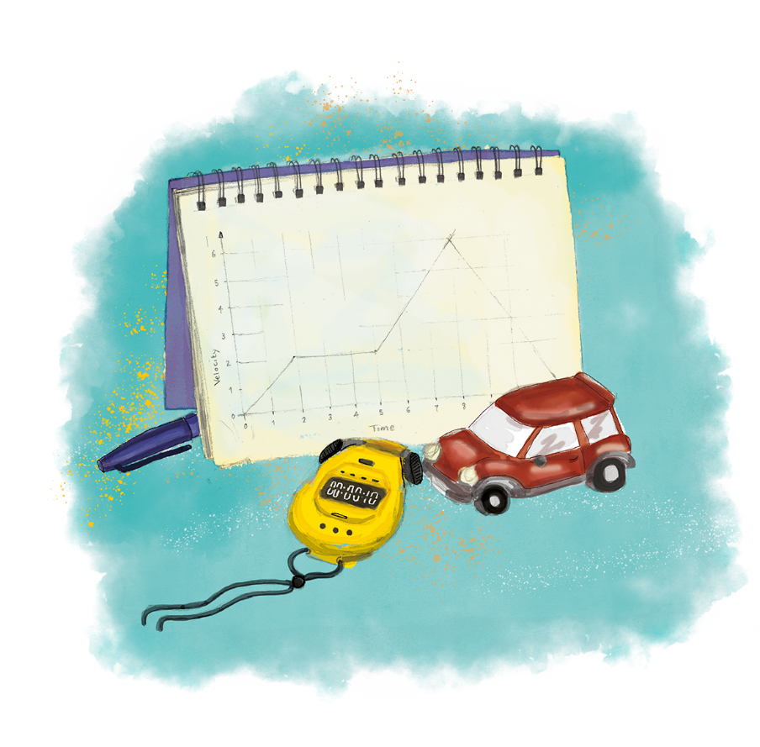


P3.1.10
01/05/2024
Velocity-Time Graphs 2
P3.1.1 Prior Knowledge Review
P3.1.2 Scalars and Vectors
P3.1.3 Resultant Vectors
P3.1.4 Resolving Vectors
P3.1.5 Newton's Third Law
P3.1.6 Newton's First Law
P3.1.7 Acceleration
P3.1.8 Acceleration Investigation
Maths in Science Lesson 17
P3.1.9 Velocity-Time Graphs
P3.1.10 Velocity-Time Graphs 2
P3.1.11 Acceleration Problems
Notes:
In the previous lesson pupils were introduced to the features of a velocity-time graphs and used them to describe the motion of objects. They also compared the features of a distance-time graph with a velocity-time graph. In this lesson they will learn the more difficult features of velocity-time graphs. The final lesson in this unit will bring all the content of motion and forces together.
Hook:
Put the introduction slide with the recap of distance-time graphs up to match the journeys to their descriptions.

Slide 4

Following this lesson, students will be able to:
Describe motion using velocity-time graphs
Calculate the gradient of the line to determine the acceleration of an object
Use a tangent to a curve to determine acceleration at a point
Key Words:
curve
gradient
tangent

Slide 5
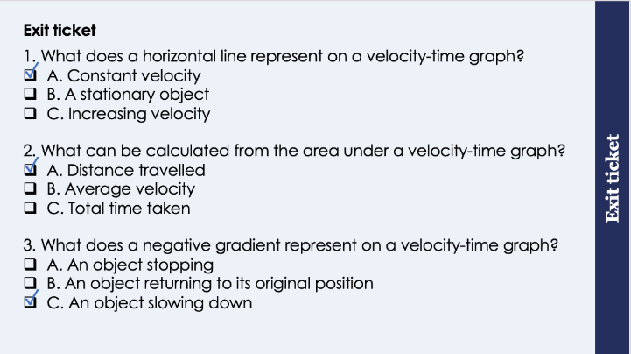
This is the fix-it portion of the lesson
The fix-it is an opportunity to respond to gaps in knowledge, especially those identified by the previous lesson’s exit ticket.
The teacher should customise this slide as needed, to facilitate
reteach, explanation, demonstration or modelling of ideas and concepts that students have not yet grasped or have misunderstood.
practise answering specific questions or of key skills.
redrafting or improving previous work.
Notes:
Suggested Guidance:
Q1. Answer: A
If students answer B they are not clear on the difference between velocity-time graphs and distance-time graphs. If students answer C they may have not understood the difference between the terms horizontal line and straight line. To fix-it pupils can summarise the meaning of features of both VT and DT graphs.
Q2. Answer: A
If students answer B or C they do not know the relationship between distance travelled and area under the graph. To fix-it, model again how to calculate the distance travelled. It may be worth explaining this in terms of velocity x time.
Q3. Answer: C
If students answer A they have assumed that a negative gradient always means an object that is stopping regardless of if it reaches the x axis. If students answer B they have not understood the differences between VT and DT graphs. To fix-it, students can annotate on a VT graph what is shown by each feature.

Slide 6
Velocity-Time Graphs
A negative velocity shows that the object is travelling in the opposite direction.
Notes:
Exposition type: explanation
Suggested exposition:
In this lesson we’re going to look at some more complicated velocity-time graphs.
Let’s look at this velocity-time graph. In this case we can see after 20 seconds that the graph dips below the x-axis. So what does this mean?
This shows that the object has a negative velocity - so what does that mean? It means that the object is travelling in the opposite direction. In this case it’s velocity becomes more negative between 20 and 25 seconds, so the velocity is increasing. This line shows that the object is getting faster (accelerating) in the opposite direction.
What is happening between 25 and 30 seconds?
There is a horizontal line so the velocity must be constant. The velocity is negative but still constant so it is travelling at the same speed but in the opposite direction.
Notes:
In A-level physics pupils will see the example of a ball bouncing, where the velocity does not decrease to 0, it just changes direction (which is represented with a dotted line).
In this case the object has stopped at 20 seconds before accelerating in the opposite direction for 5 seconds before reaching a new constant speed, also in the opposite direction.
Convention is to use forwards as positive on the y axis and backwards as negative. At this level they will mostly just be using forwards and backwards unless an initial direction is stated, which is usually taken to be the positive direction.

Slide 7

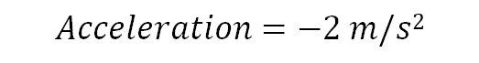





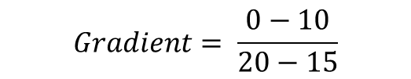
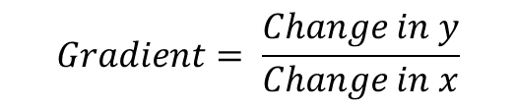
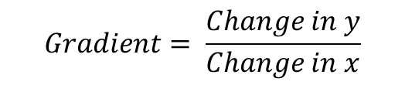
Velocity-Time Graphs
$$Gradient= \frac{Change in y}{Change in x}$$
$$Gradient= \frac{0−10}{20−15}$$
$$Gradient= \frac{Change in y}{Change in x}$$
$$Gradient= \frac{−10}{5}$$
$$Gradient= \frac{10−5}{10−5}$$
$$Gradient=− 2$$
$$Gradient= \frac{5}{5}$$
$$Acceleration=−2 m/s2$$
$$Gradient=1$$
$$Acceleration=1 m/s2$$
Notes:
Exposition Type: Explanation
Suggested Exposition:
This is the same example used from the previous lesson as a quick recap of what the gradient on a velocity-time graph is used for.
What can we calculate from the gradient (slope) of a velocity-time graph?
Acceleration. This is a measure of how quickly the velocity changes (how much velocity changes per unit time).

Slide 8
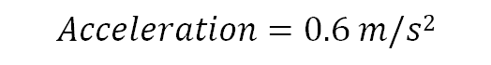



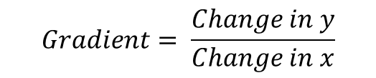
Velocity-Time Graphs
A curved line on a velocity-time graph indicates that the acceleration is changing.
The acceleration at a specific point in time can be calculated by drawing a tangent to the curve and calculating the gradient of the tangent.
$$Gradient= \frac{Change in y}{Change in x}$$
$$Gradient= \frac{8−2}{10−0}$$
$$Gradient= \frac{6}{10}$$
$$Gradient=0.6$$
$$Acceleration=0.6 m/s2$$
Notes:
Calculating the gradient of a tangent is covered in much more detail with rates of reaction in Year 11. In this lesson, as a stretch, you may want to show students how to calculate the gradient of the tangent that has been drawn for them, but they are not expected to draw the tangent themselves at this stage.
Suggested Exposition:
So we know that we can calculate acceleration from the gradient of a distance-time graph, but what if the gradient changes? On some velocity-time graphs you may see a curved line. Instead of there being a constant acceleration (i.e. the object changes velocity by the same margin during each time interval), this means there is a changing acceleration and the velocity does not change uniformly (i.e. during some time intervals the velocity will change by more or less).
To calculate the acceleration of an object when the line is curved we need to draw a tangent of the curve and determine the gradient of the tangent.
For example: We can calculate the acceleration of this object at 5 seconds.
This is a curve at this point so we need to draw a tangent to the curve. Annotate tangent.
We can then use the tangent to determine the gradient of the tangent and therefore the acceleration.
Annotate the working.
Increasing acceleration is where the curve is getting steeper (because the velocity is increasing, more distance is being covered per unit time) and decreasing acceleration is where the curve is getting flatter (because the velocity is decreasing, less distance is being covered per unit time).
Notes:
May be useful to introduce the terms uniform (i.e. constant) and non-uniform (changing) acceleration with reference to a constant gradient versus a curve.
Drawing a tangent to the curve is also used to calculate instantaneous speed on a distance-time graph so this is a useful skill for pupils to master. It is a requirement for Higher tier so you may want to consider how appropriate it is to introduce to your class.

Slide 9
Quick Quiz:
What does a curved line represent on a velocity-time graph?
What does it mean for an object to have a negative velocity?
What can be calculated from the gradient of a velocity-time graph?
It shows the acceleration is changing.
The object is travelling in the opposite direction.
Acceleration
Notes:
Purpose: review of new information.

Slide 10

Can you explain the difference between these two velocity-time graphs?
+
What does the gradient represent on a velocity-time graph?
Are the gradients constant?
What does it mean that they both have positive values for velocity?
Velocity
Time
_
+
Velocity
Time
_
Notes:
Guidance: this is the key point for pupils to understand from this lesson - a curved line represents a changing acceleration.
You may want to give pupils time to think, pair, share or work in groups with a spokesperson to feed back to the class.
Stretch: describe a scenario that would result in each of these velocity-time graphs.
Suggested guidance:
Talk tasks can be used in a variety of ways to suit the particular needs of the students you are teaching. Through exchanging views with others, students develop their understanding of the science beyond what could be achieved individually.
Science classrooms that successfully integrate talk have the following features:
Science talk is a regular feature of lessons and is woven into classroom activities.
Students are paired or grouped strategically by the teacher to ensure productive interaction. This might take into consideration the students’ proficiency of the English language, how encouraging they might be to peers and their attainment in the topic. It’s a good idea to consider these pairings in the class seating plan.
Students are encouraged and supported to talk, but are not forced to talk.
The teacher should take on the role of a facilitator, engaging with conversations where necessary and encouraging or steering the conversation where needed.
Students are encouraged to use the language they have to express their ideas (e.g., everyday language, imperfect English, native language), but also to incorporate science specific terminology where this is more accurate or has been taught.
6. Scientifically inaccurate ideas are not dismissed by the partner or teacher; open discussion and further investigation are relied on to help students construct ideas that support them to progress in their scientific understanding.
7. Guidelines for behaviour during talk tasks are explicit and frequently reviewed. Rules for students might be:
Listen carefully to your partner
Take turns talking.
Speak one at a time, without interrupting.
Politely agree or disagree and explain why.
Politely point out if your partner has used a scientific word incorrectly, if they have explained the science incorrectly, or if there is a more accurate way to describe something.
If confused, ask questions.
Stay focused on the discussion topic.
Respond to one another.

Slide 11
Drill
How can you tell that an object is travelling in the opposite direction on a velocity-time graph? On the graph, what is the acceleration between 0-5s?
On the graph, what is the acceleration in the last 5s?
What does a curved line on a velocity-time graph tell you?
Notes:
Purpose: This is a knowledge drill. The purpose of this is to check that the critical knowledge is secure before pupils move onto independent practice.
Suggested guidance: There are a range of ways this could be done depending on time and ability range of the class:
Mini whiteboards
As full sentences in exercise books
As short answers in exercise books
In the pupil workbook
As pair talk
As cold call

Slide 12
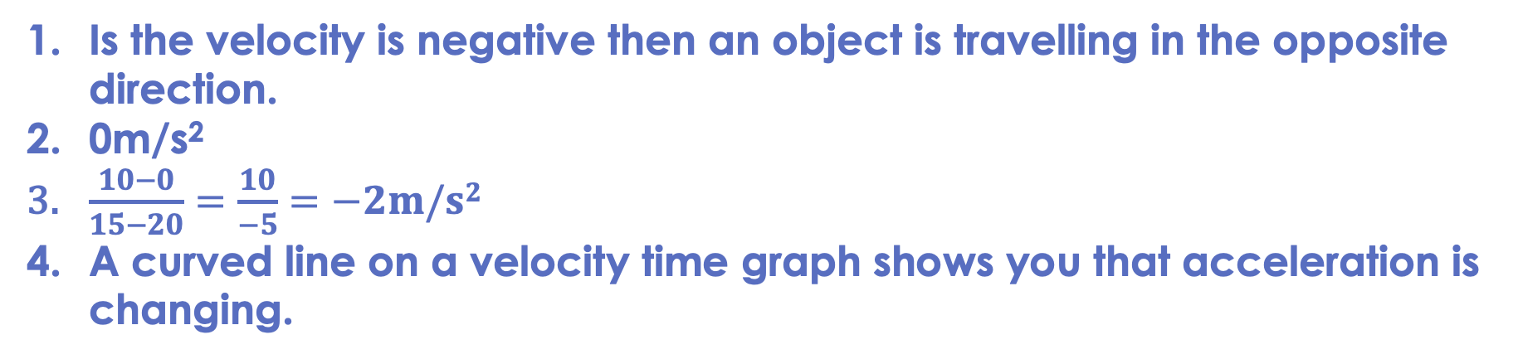
Drill answers
Is the velocity is negative then an object is travelling in the opposite direction. 0m/s²
$\frac{10−0}{15−20}=\frac{10}{−5}=−2m/s2$
A curved line on a velocity time graph shows you that acceleration is changing.
Notes:
Purpose: This is a knowledge drill. The purpose of this is to check that the critical knowledge is secure before pupils move onto independent practice.
Suggested guidance: There are a range of ways this could be done depending on time and ability range of the class:
Mini whiteboards
As full sentences in exercise books
As short answers in exercise books
In the pupil workbook
As pair talk
As cold call

Slide 13
Balanced and Unbalanced Forces
We can use a velocity-time graph to determine if the forces acting on an object are balanced or unbalanced.
Which parts of the graph show balanced forces?
Which parts of the graph show unbalanced forces?
Explain your answers.
Notes:
Guidance:
This talk task can also be used as a separate activity, or pupils can add ‘balanced/unbalanced’ onto the VT graphs on their worksheets.
The aim of this task is to get pupils to continue making the link between forces and motion.
Only an unbalanced force can change the motion of an object, which in this case is changing the velocity.
Therefore the parts of the graph where the velocity is changing show unbalanced forces (between 5 and 10 seconds, and then again between 15 and 20 seconds).
Balanced forces cannot change the motion of an object, so where velocity is constant the forces must be balanced (anywhere there is a horizontal line - between 0 and 5 seconds and then again between 10 and 15 seconds).
Suggested guidance:
Talk tasks can be used in a variety of ways to suit the particular needs of the students you are teaching. Through exchanging views with others, students develop their understanding of the science beyond what could be achieved individually.
Science classrooms that successfully integrate talk have the following features:
Science talk is a regular feature of lessons and is woven into classroom activities.
Students are paired or grouped strategically by the teacher to ensure productive interaction. This might take into consideration the students’ proficiency of the English language, how encouraging they might be to peers and their attainment in the topic. It’s a good idea to consider these pairings in the class seating plan.
Students are encouraged and supported to talk, but are not forced to talk.
The teacher should take on the role of a facilitator, engaging with conversations where necessary and encouraging or steering the conversation where needed.
Students are encouraged to use the language they have to express their ideas (e.g., everyday language, imperfect English, native language), but also to incorporate science specific terminology where this is more accurate or has been taught.
6. Scientifically inaccurate ideas are not dismissed by the partner or teacher; open discussion and further investigation are relied on to help students construct ideas that support them to progress in their scientific understanding.
7. Guidelines for behaviour during talk tasks are explicit and frequently reviewed. Rules for students might be:
Listen carefully to your partner
Take turns talking.
Speak one at a time, without interrupting.
Politely agree or disagree and explain why.
Politely point out if your partner has used a scientific word incorrectly, if they have explained the science incorrectly, or if there is a more accurate way to describe something.
If confused, ask questions.
Stay focused on the discussion topic.
Respond to one another.

Slide 14
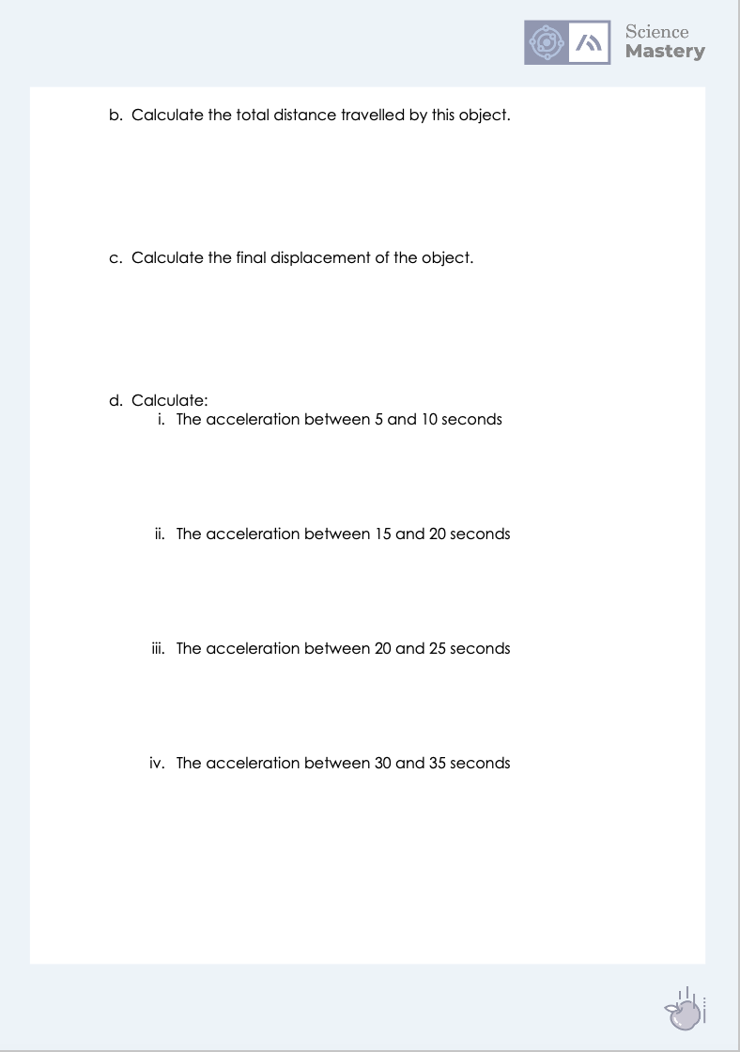
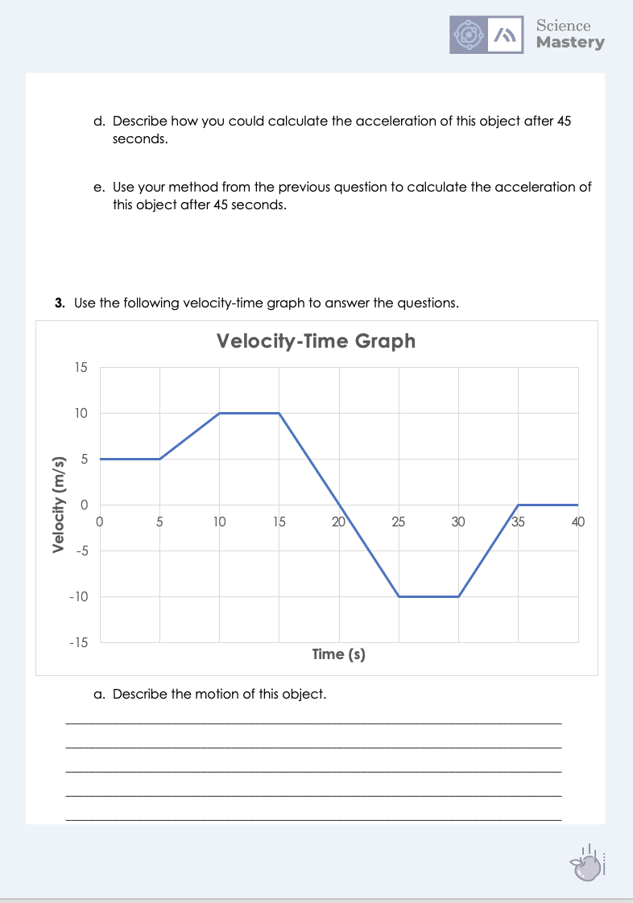
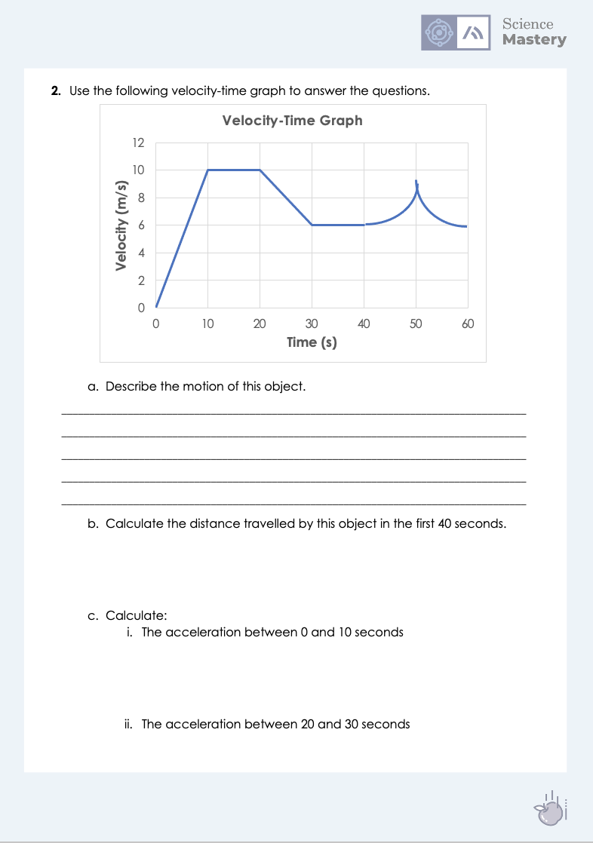
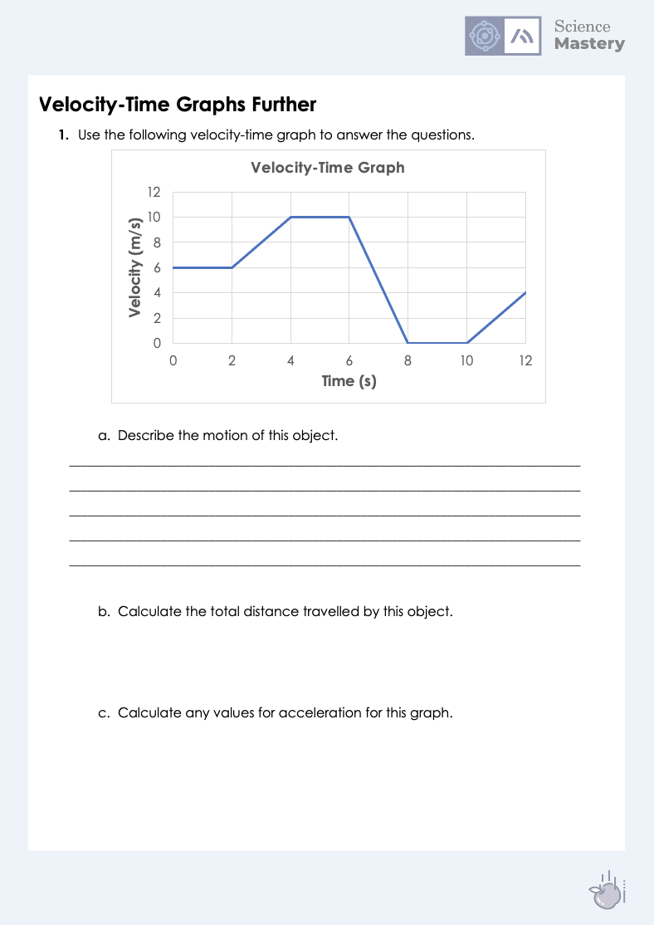
Velocity-Time Graphs Further
Complete the velocity-time graph further activity.
Describe the motion of each object.
Calculate the distance travelled by each object.
Calculate the acceleration where required.
Ensure you show all working.
Notes:
Purpose: apply new information
Calculating the gradients should be relatively straightforward for most pupils (with the exception of the gradient of the tangent) but the challenging part is thinking about what the acceleration/deceleration actually means.
Calculating the displacement is a very complex skill so you may want to consider including this for your class.
Stretch - mark on each graph where the forces are balanced and where are they unbalanced.
Stretch suggestion - get pupils to write their own scenarios and draw their own velocity-time graphs for other pupils to use for further practice.

Slide 15
Answers
1c. Acceleration = gradient
Between 2 and 4 seconds:
Gradient = Change in y
Change in x
Gradient = 10-6
4-2
Acceleration = 2 m/s²
Between 6 and 8 seconds:
Gradient = Change in y
Change in x
Gradient = 0 - 10
8 - 6
Acceleration = -5 m/s²
Between 10 and 12 seconds:
Gradient = Change in y
Change in x
Gradient = 4 – 0
12 – 10
Acceleration = 2 m/s²
1a.
Constant speed of 6 m/s for 2 seconds
Object accelerates (uniformly) from 6 m/s to 10 m/s in 2 seconds
Constant speed of 10 m/s for 2 seconds
Object decelerates to a stop within 2 seconds
Object is stationary (velocity = 0 m/s) for 2 seconds
Object accelerates from rest to 4 m/s in another 2 seconds
1b. Distance travelled = area under the graph
Area under the graph = (2 x 6) + (2 x 6) + (1/2 x 2 x 4) + (2 x 10) + (1/2 x 2 x 10) + (1/2 x 2 x 4)
Area under the graph = 62 m

Slide 16
Answers
2 ci.
Gradient = Change in y
Change in x
Gradient = 10 – 0
10 – 0
Acceleration = 1 m/s²
2a.
Object accelerates from 0 to 10 m/s in 10 seconds
Constant velocity for another 10 seconds
Object decelerates from 10 m/s to 6 m/s in 10 seconds
Constant velocity for another 10 seconds
Increasing acceleration (non-uniform) for 10 seconds
Decreasing deceleration (non-uniform) for 10 seconds
2 cii.
Gradient = Change in y
Change in x
Gradient = 6 – 10
30 – 20
Acceleration = -0.4 m/s²
2b. Distance travelled = area under the graph
Area under the graph = (1/2 x 10 x 10) + (10 x 10) + (10 x 6) + (1/2 x 10 x 4)
Area under the graph = 230 m

Slide 17
Answers
2d. Draw a tangent to the curve and determine the gradient of the tangent.
2e. Stretch
Tangent drawn on graph (these answers will vary depending on how the tangent has been drawn because it is not on square paper, but should be within 0.2 m/s²)
Gradient = Change in y
Change in x
Gradient = 9 – 4
60 - 35
Acceleration = 0.2 m/s²

Slide 18
Answers
3b.
Distance travelled = area under the graph
Area under the graph = (5 x 5) + (5 x 5) + (1/2 x 5 x 5) + (5 x 10) + (1/2 x 5 x 10) + (1/2 x 10 x 5) + (5 x 10) + (1/2 x 5 x 10)
Area under the graph = 237.5 m
3a.
Constant speed of 5 m/s for 5 seconds
Object accelerates (uniformly) from 5 m/s to 10 m/s in 5 seconds
Constant speed of 10 m/s for 5 seconds
Object decelerates (uniformly) from 10 m/s to rest in 5 seconds
Object accelerates (uniformly) from rest to 10 m/s in the opposite direction for 5 seconds
Constant speed of 10 m/s in the opposite direction for 5 seconds
Object decelerates to rest in another 5 seconds
Object is stationary for 5 seconds
3c.
Displacement = area under the graph (with direction factored in)
Area under the graph = (5 x 5) + (5 x 5) + (1/2 x 5 x 5) + (5 x 10) + (1/2 x 5 x 10) + (1/2 x (-10) x 5) + (5 x (-10)) + (1/2 x 5 x (-10))
Displacement = 37.5 m forwards from original position.

Slide 19
Answers
4 diii.
Gradient = Change in y
Change in x
Gradient = -10 – 0
25 – 20
Acceleration = -2 m/s² (accelerating in the opposite direction)
4 di.
Gradient = Change in y
Change in x
Gradient = 10 – 5
10 – 5
Acceleration = 1 m/s²
4 dii.
Gradient = Change in y
Change in x
Gradient = 0 – 10
20 – 15
Acceleration = -2 m/s² (slowing down)
4 div.
Gradient = Change in y
Change in x
Gradient = 0 – (-10)
35 – 30
Acceleration = 2 m/s² (decelerating in opposite direction, double negative)

Slide 20
Answer the questions below.
What can be calculated from the gradient of a velocity-time graph?
A. Distance travelled
B. Acceleration
C. Velocity
2. What does a curved line represent on a velocity-time graph?
A. Constant velocity
B. Constant acceleration
C. Changing acceleration
3. Which of these would not have a negative value for acceleration?
A. An object speeding up in the opposite direction
B. An object slowing down
C. A stationary object
✓
✓
✓
Notes:
Suggested Guidance:
Q1. Answer: B
If students answer A, they may have confused gradient with area under the graph. If students answer B, they may have confused VT and DT graphs. To fix-it pupils can practice calculating acceleration from the gradient at different points on a VT graph.
Q2. Answer: C
If students answer A, they have not understood the significance of the horizontal line on a VT graph. If students answer B, they may not understand the difference between constant and changing acceleration. To fix-it you may want to go through a curved section of a graph and calculate the gradient at different points to illustrate to pupils that the acceleration is not constant.
Q3. Answer: C
If students answer A or B, they have not understood the meaning of a negative value for acceleration. To fix-it you may want to model calculations of the scenarios in A and B to show how you arrive at a negative value for acceleration.

Slide 21
Lesson P3.1.10
What was good about this lesson? | What can we do to improve this lesson?
Send us your feedback by clicking this link
or by emailing sciencemastery@arkonline.org
Thank you!

